Slide 1
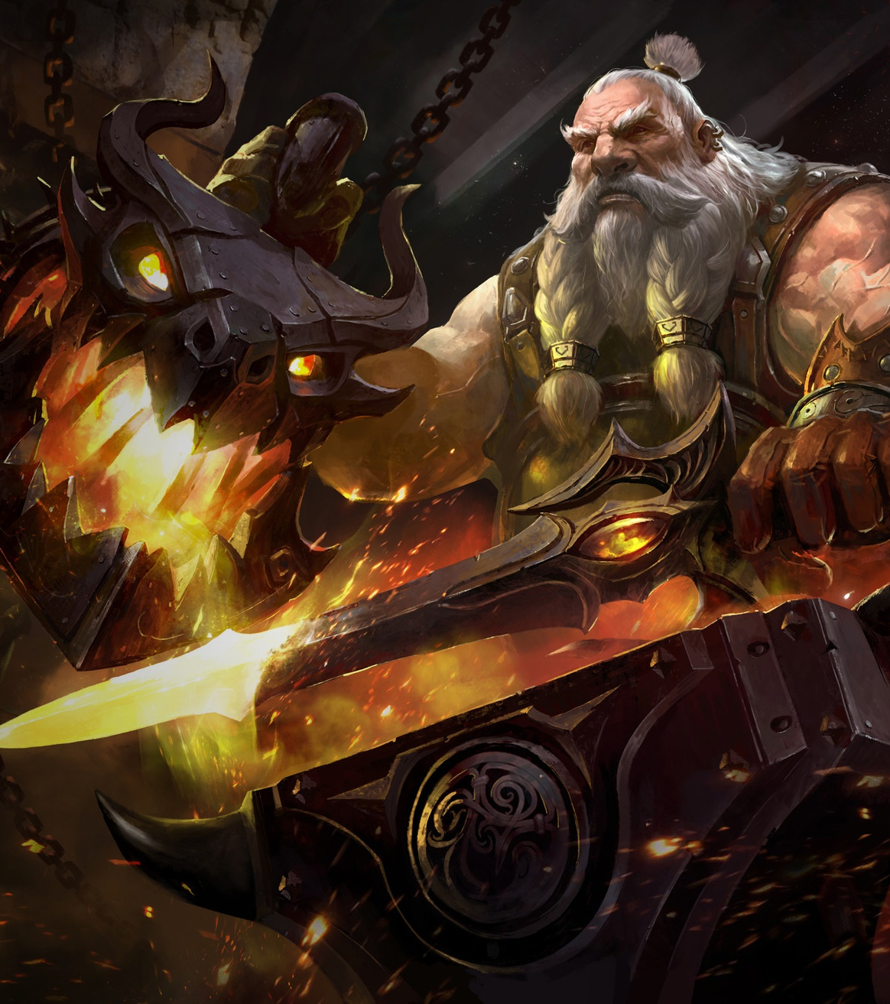

Warcraft weapons
An ETL project by Phil Quintanilla

Slide 2
Extraction
For this project I used the World of Warcraft items dataset from Kaggle. This dataset is filled with items that can be equipped by characters in World of Warcraft. For the purpose of this project, I only used items that could be equipped in the weapon slots. The csv’s used from this dataset were Main Hand, Off Hand, One-Hand, Ranged, and Two Hand. At the time of this dataset World of Warcraft was on patch 8.2.5 which was released 09/24/2019. For reference World of Warcraft is now on patch 9.0.2 as of 12/23/2020.
Please note: There are other weapon slot CSV’s in the data set, Held in Off-Hand, Thrown, and Shield but these items are not considered weapons as Held in Off-Hand Items just provide a boost to a character's stats, thrown weapons are no longer used as weapons and generally used for cosmetic or role-playing purposes and shields are considered an armor boost and not a weapon boost.

Slide 3
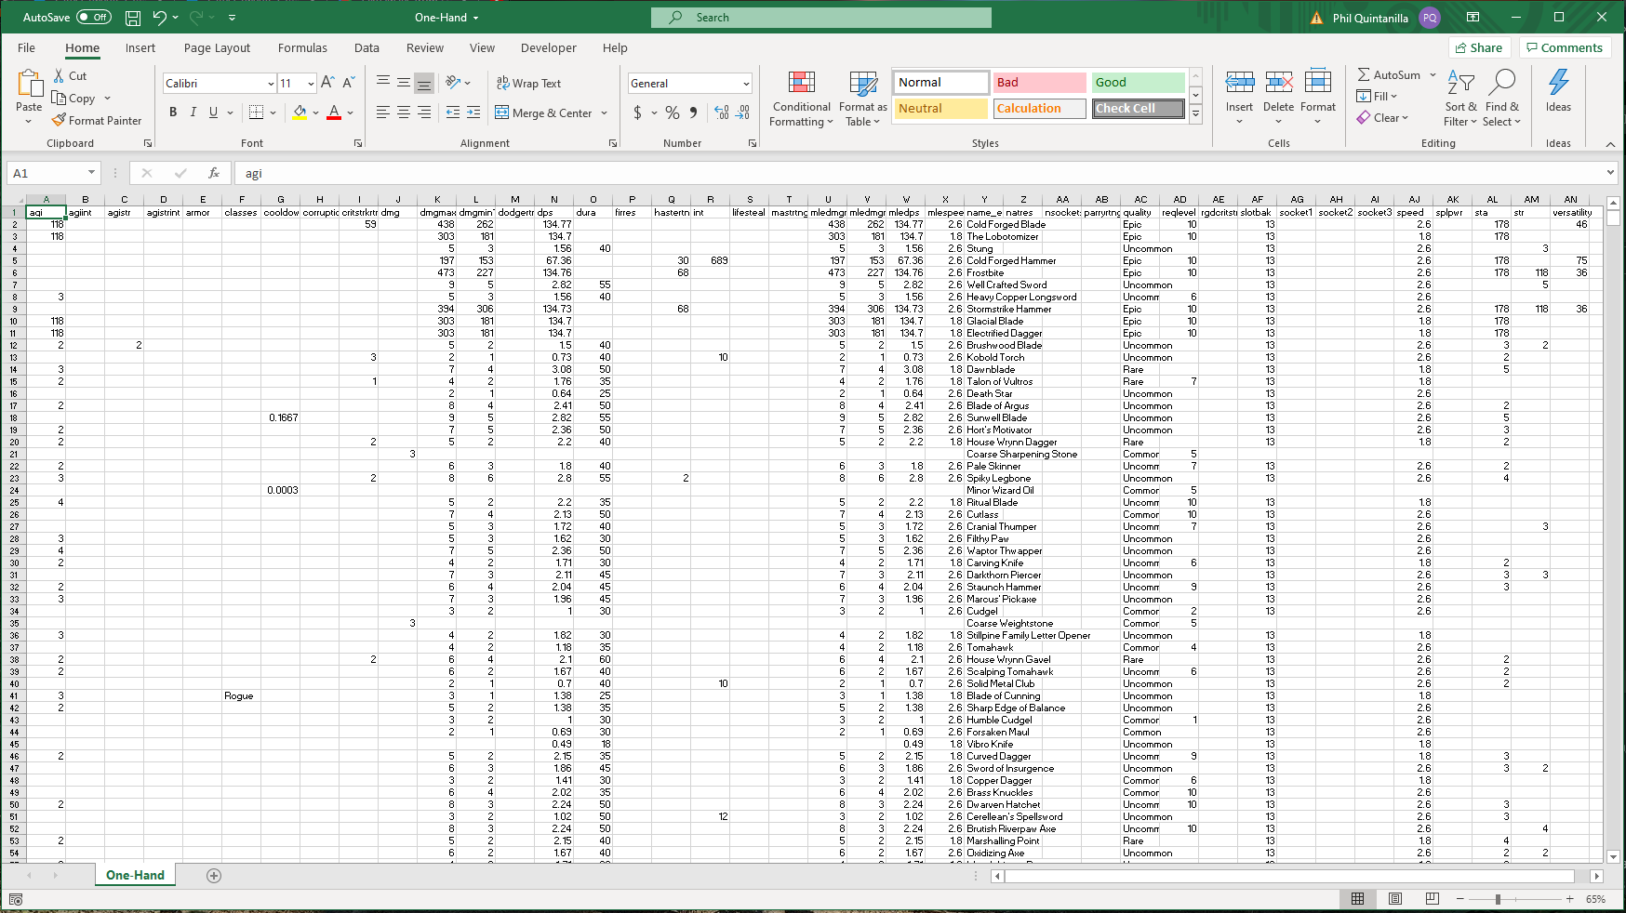
Data clean-up

Slide 4
Transform
As seen in the previous slide the CSV’s have a lot of columns with useless information. There are columns that are completely empty and not all weapons have agility(agi) or class requirements(classes).
When transforming the data, I only wanted the data that was relevant to damage and identification.
I limited my data to the following columns
Name_enus, Name of weapon
Quality, The rarity of the item
Dmgmin1, the lowest amount of damage a weapon could do
Dmgmax1, the highest amount of damage a weapon could do
DPS, the average amount of damage the weapon would do in a second
And mlespeed for melee weapons or rngspeed for ranged weapons, amount of time it took to swing with a weapon
After this was completed, I gave the columns clearer names

Slide 5
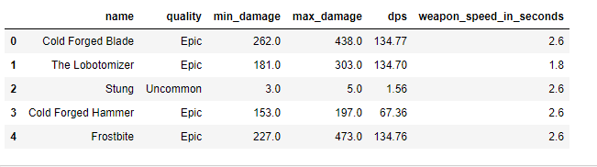
Cleaned Data Frame

Slide 6
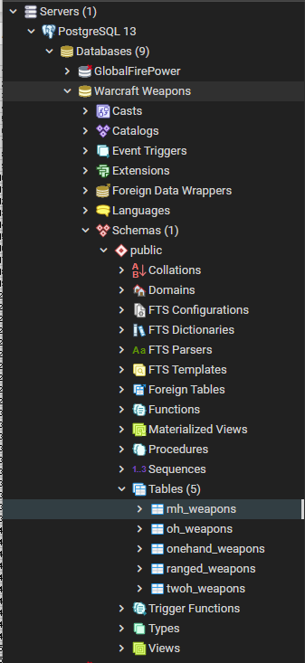
Load
After each data frame was cleaned, they were loaded into a PgAdmin database.

Slide 7
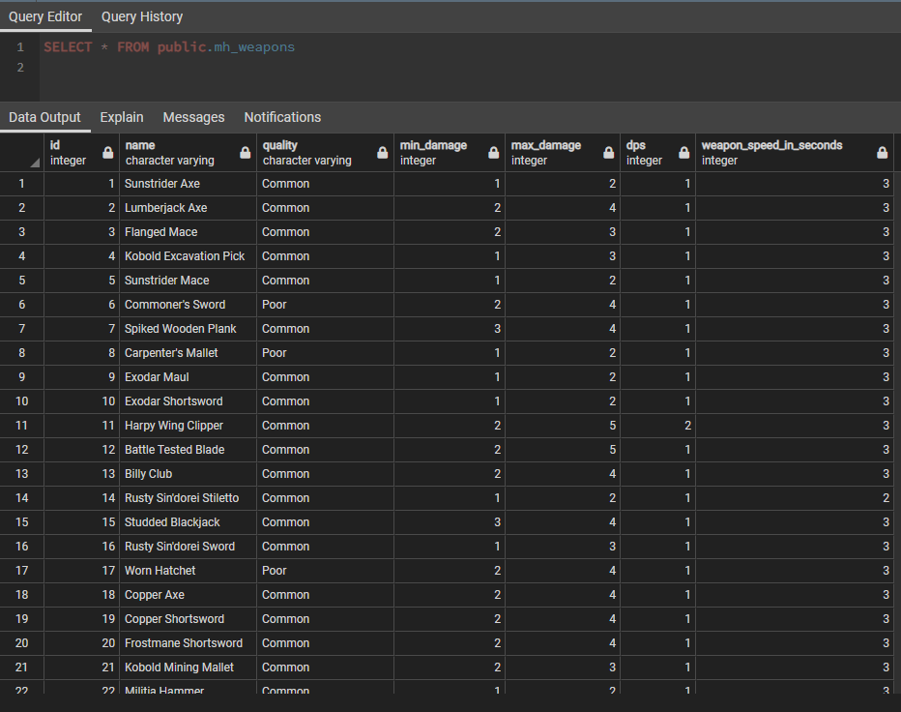

Slide 8
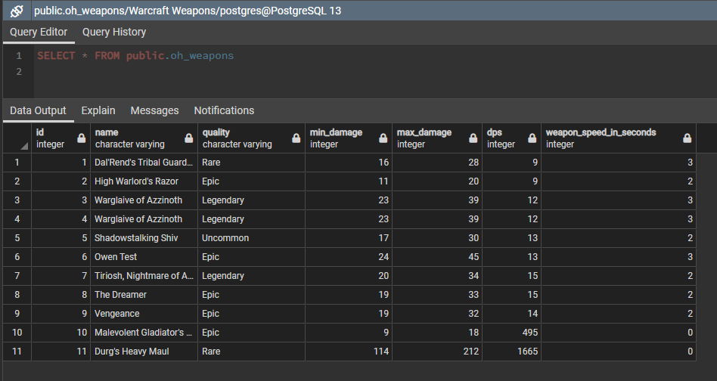

Slide 9
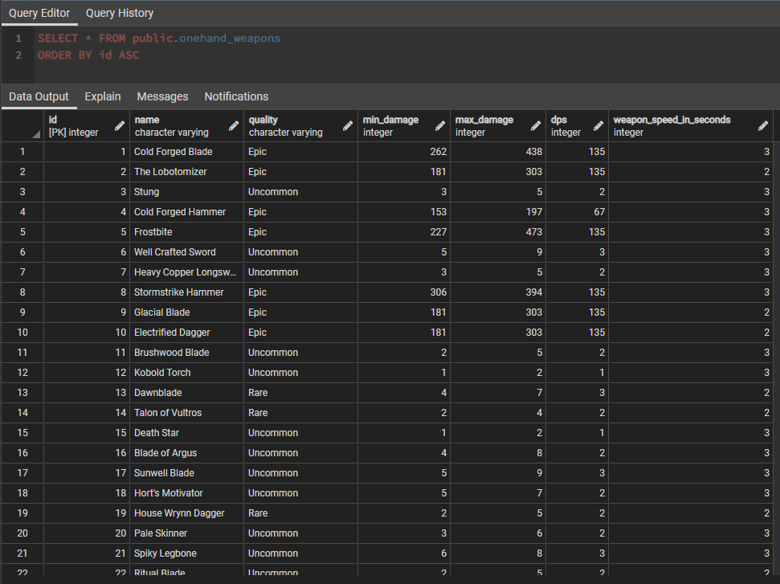

Slide 10
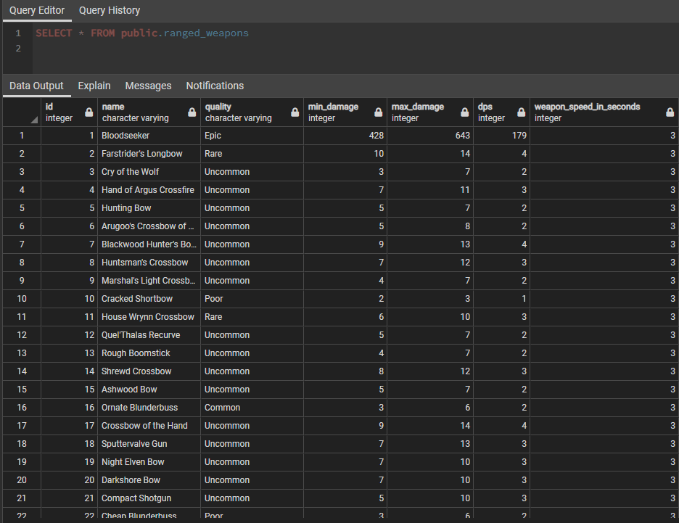

Slide 11
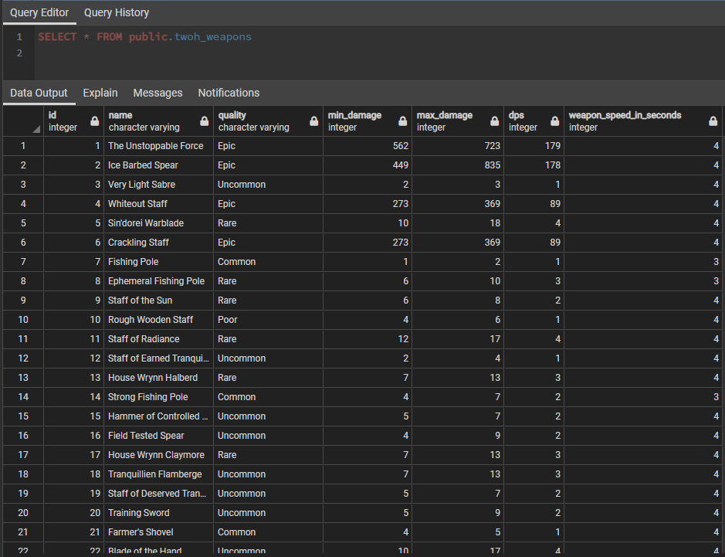

Slide 12
ETL: Conclusion
This was a fun project, and I was thankful to have an opportunity to work with a dataset for a game that I have been playing for more than 10 years. I wish this dataset had broken the items into type such as axe, sword, or bow and was more up to date with items. It also seemed while cleaning the data some weapons would appear on multiple csv’s which is probably due to WoW’s main-hand/off-hand/one-hand categories since these should all be considered one-hand weapons, but itemization has gone through a lot of changes through the lifetime of the game.

